Slide 1
Pandemic Life Style

Slide 2
Agenda:
To understand the overall health condition
To identify the lifestyle of our people
To understand the factor that are affecting people’s health
To arrive at a positive lifestyle
Pandemic Life Style - Google Form
Pandamic Style Style - Response Dump

Slide 3
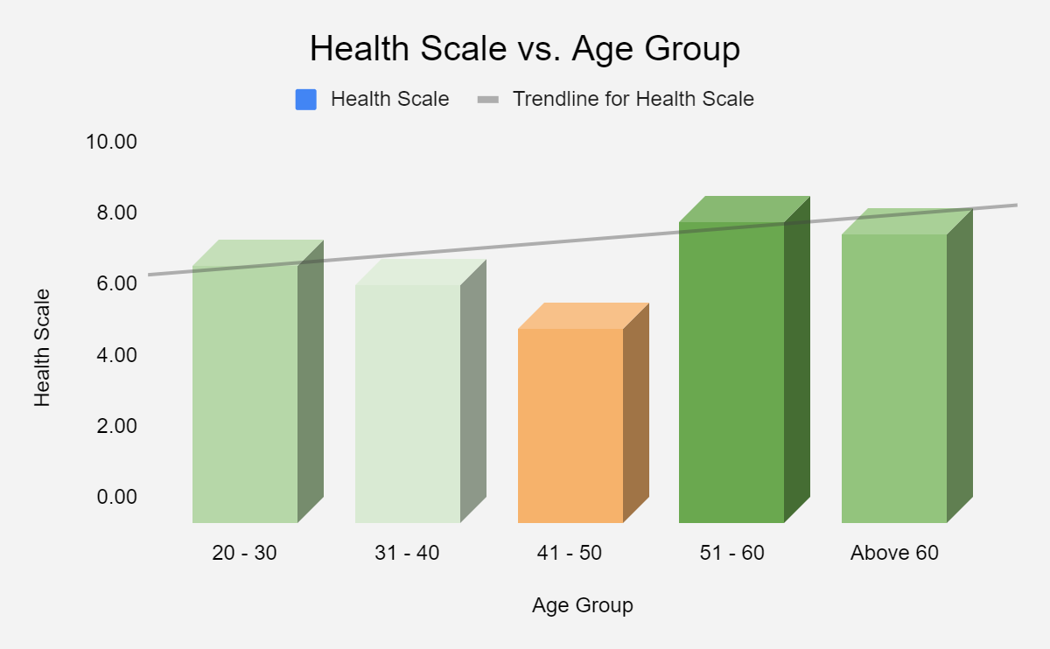
Pandemic Life style:
This study is based on the below parameters:
The age factor and the health scale our people
Health based on the type of foodie, # of meals, amount of water consumption, meal time adherence and daily workout
Gender based and geographical based classification to identify the healthy lifestyle

Slide 4
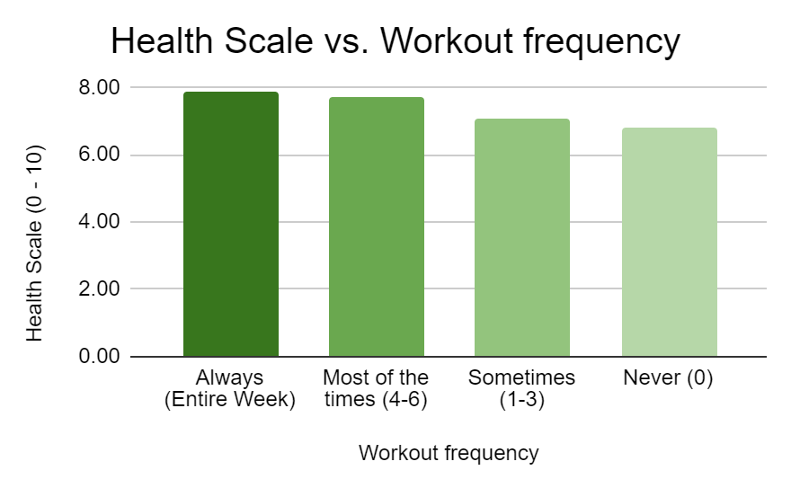
Pandemic Life style:
Below is a workout frequency of our people based on age groups:
Healthy is an outfit that looks different on everybody
Work out Frequency | 20-30 | 31-40 | 41-50 | 51-60 | Above 60
Always (Entire Week) | 16% | 10% | NIL | 25% | 17%
Most of the times (4-6) | 14% | 20% | 50% | 25% | 50%
Never (0) | 18% | 50% | 50% | NIL | 17%
Sometimes (1-3) | 50% | 20% | NIL | 50% | 17%
We can conclude that people who workout throughout the week are the healthiest ones from the responses
People in the age group of 20 - 30 work out the most throughout the week

Slide 5
Pandemic Life style:
Food Habits and its effects:
# of Meal/day | Health Scale
1 | 5.25
2 | 6.84
3 | 7.63
4 | 6.00
Skip Breakfast | Health Scale
Always (Entire Week) | 5.60
Most of the times (4-6) | 7.14
Never (0) | 7.60
Sometimes (1-3) | 7.24
Delayed Dinner | Health Scale
Always (Entire Week) | 6.20
Most of the times (4-6) | 6.92
Never (0) | 7.81
Sometimes (1-3) | 7.19
3 complete meal a day would directly contributes towards healthy lifestyle
This study shows people who do not skip breakfast are more healthier than others
It is observed that people who never eat delayed dinner are the ones who are the healthiest ones.

Slide 6
Pandemic Life style:
How can I build a healthy lifestyle during this Pandemic period:
Make sure to have 3 complete meals a day
Never skip breakfast
Never delay your dinner
Make sure to work out at least 5 times a week despite your busy life style
Few other suggestions to stay safe and healthy:
Try avoiding the crowded places during this Covid pandemic time
Wear mask and make sure to use sanitizer or wash hands regularly
Avoid unnecessarily stepping out from your home
Stay home, Stay safe

Slide 7

Pandemic Life style:

